Slide 1
BASIC STATISTICS CLASS-1

Slide 2
Revision

Slide 3
COURSE AGENDA
Statistics
Data Mining- Supervised & Unsupervised
Text Mining/ NLP
Data Visualization
Forecasting

Slide 4
AGENDA
Datatypes- Continuous, Discrete , Nominal, Ordinal, Interval, Ratio, Random Variable, Probability Distribution
First, second, third and Fourth moment business decision.
Graphical representation- bar plot, histogram, boxplot, scatter diagram
Simple Linear Regression
Hypothesis Testing

Slide 5
DATATYPES
QUANTITATIVE
QUALITATIVE
“The sky is beautiful today”
“This towel is so soft”
CONTINUOUS
DISCRETE

Slide 6
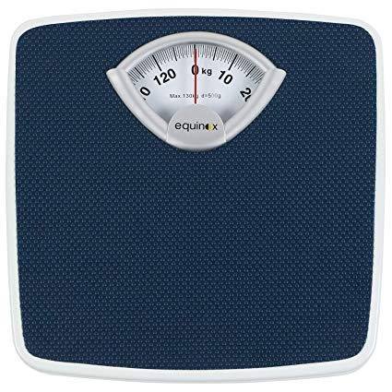
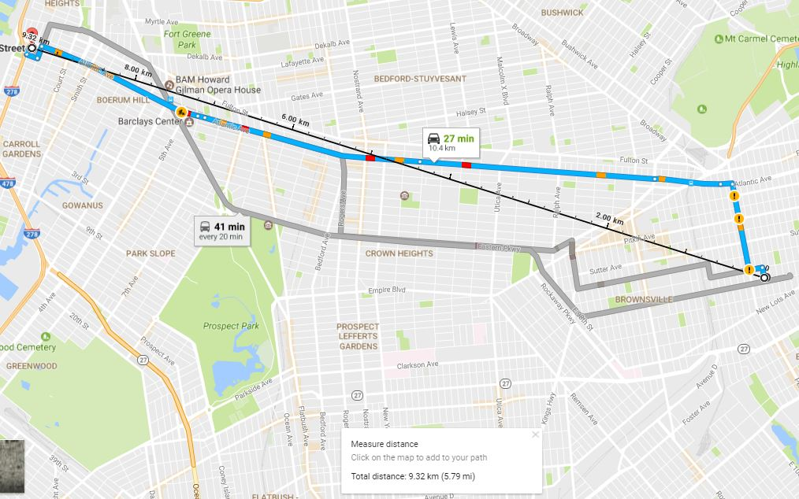
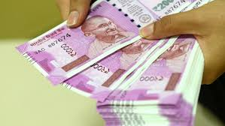
DATA TYPES- Continuous

Slide 7
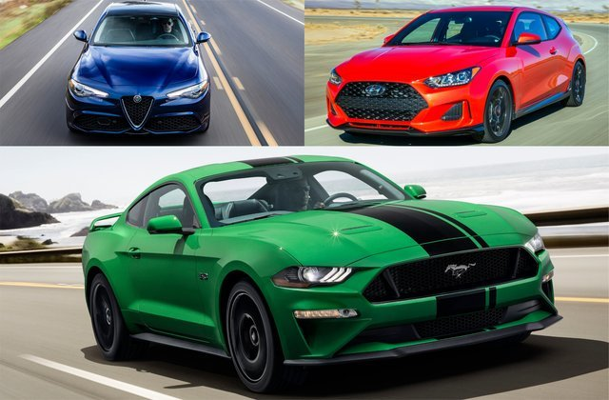
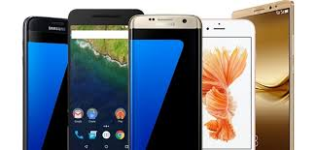
DATA TYPES- Discrete

Slide 8
Data & Measurement Scales- Preliminaries
Nominal – Merely labels. No further information can be gleaned.
E.g.: Coke and Pepsi; Honda and Toyota
Ordinal – Conveys Preference Information alone.
E.g.: I prefer Honda Activa over TVS Jupiter
Interval – Conveys relative magnitude information in addition to preference
E.g.: Ratings
Ratio – Conveys information on an absolute scale.
E.g.: Money Paid

Slide 9
Statistical Analysis of Data Types
NOMINAL | ORDINAL | INTERVAL | RATIO
Mode | Mode | Mode | Mode
Frequencies | Median | Median | Median
Percentages | Frequencies | Mean | Mean
Few Statistical Analysis | Percentages | Frequencies | Frequencies
 | Some Statistical Analysis | Percentages | Percentages
 |  | Variance | Variance
 |  | Standard Deviation | Standard Deviation
 |  | Most Statistical Analysis | Ratio of Numbers
 |  |  | All Statistical Analysis

Slide 10

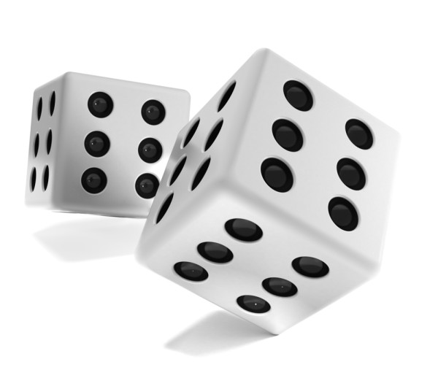
Random Variable
A Random Variable describes the probabilities from uncertain future numerical outcome of a random process
It’s variable because it can take one of several possible values.
It’s random because there is some chance associated with each possible value.

Slide 11

Probability
$$Probability=\frac{Interested Events}{Total Number of Events}$$

Slide 12
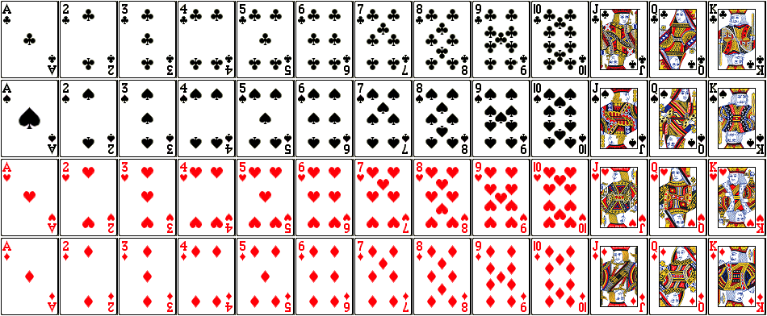
From the Deck of cards:
What is the probability of drawing a heart?
What is the probability of drawing a three?
What is the probability of drawing a card greater than 10?
What is the probability of drawing a card greater than 3, less than 8?

Slide 13
Probability Distribution
A Probability Distribution is a table or an equation that links each outcome of a statistical experiment with its probability of occurrence.
Consider the table:
Number of Phone sales (x) | Probability(X=x)
0 | 0.25
1 | 0.50
2 | 0.25
3 | 0.50
What is the probability of a sale?
What is the probability of at least two sales?

Slide 14
Types of Probability Distribution
Continuous
Discrete

Slide 15
Probability Distribution

Slide 16
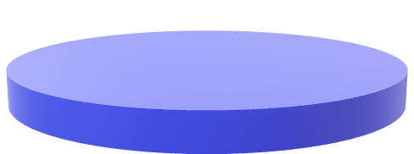

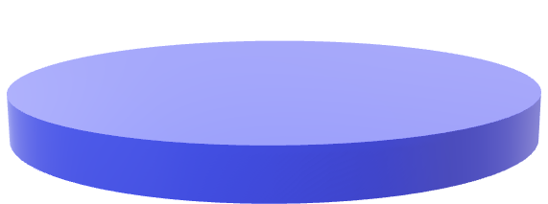
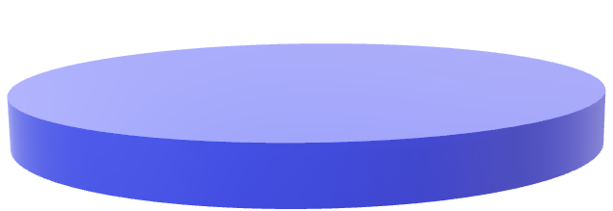
Sampling Funnel
POPULATION SAMPLE
FRAMING SAMPLE
SRS
SAMPLE

Slide 17
EXPLORATORY DATA ANALYSIS

Slide 18
Collect the data and the domain knowledge
Confirm datatypes and probabilities
Measures of Central tendency
Measures of Dispersion
Skewness and Kurtosis
Graphical Representation

Slide 19
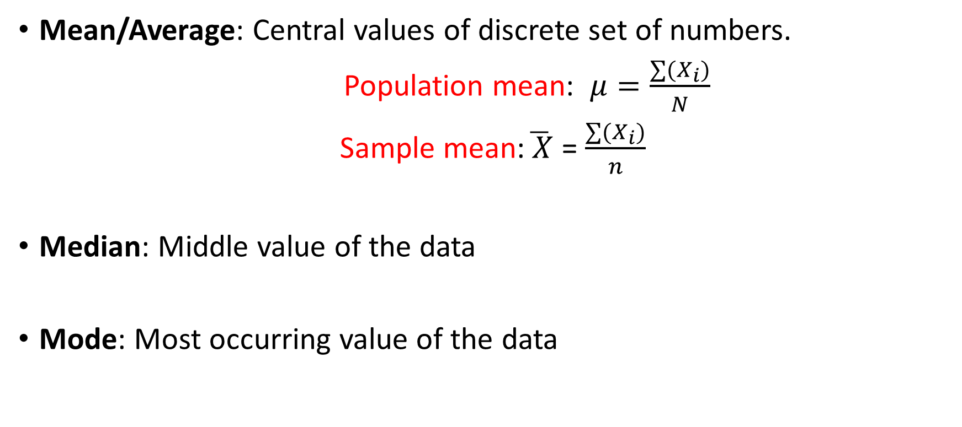
Measures of Central Tendency
Mean/Average: Central values of discrete set of numbers.
Population mean: $μ=\frac{∑(X_{i})}{N}$
Sample mean:$\overline{ X}$ = $\frac{∑(X_{i})}{n}$
Median: Middle value of the data
Mode: Most occurring value of the data

Slide 20

Measures of Dispersion
MACHINE A
MACHINE B
USL= 229mm
$$\overline{X}$$
LSL =224mm
Dispersion is defined as the distance between the data point to the average

Slide 21
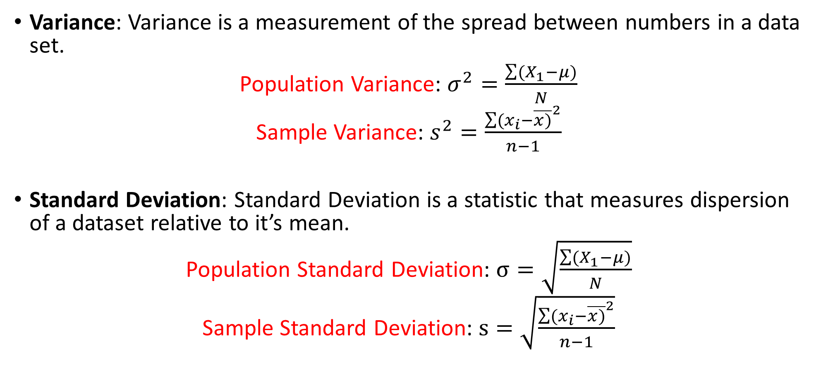
Measures of Dispersion
Variance: Variance is a measurement of the spread between numbers in a data set.
Population Variance: $σ^{2}=\frac{\sum{(X_{1}−μ)}}{N}$
Sample Variance: $s^{2}=\frac{{\sum{(x_{i}−\overline{x)}}}^{2}}{n−1}$
Standard Deviation: Standard Deviation is a statistic that measures dispersion of a dataset relative to it’s mean.
Population Standard Deviation: $σ=\sqrt{\frac{\sum{(X_{1}−μ)}}{N}}$
Sample Standard Deviation: $s=\sqrt{\frac{{\sum{(x_{i}−\overline{x)}}}^{2}}{n−1}}$

Slide 22

Measures of Dispersion
Range: The difference between lowest and highest values.
$$Range= Max−Min$$

